Slide 1
Product Team Update
Technology Roadmap (26FE15)

Slide 2
Technology Roadmap Process Enhancements
Restructured the Tech Roadmap
  Manage project data and progress
  Manage and assess risk
  Improve user interface to more efficiently
Incorporate Milestone Management
  Provide initiative status visibility
  Facilitate advanced planning
Improve Tech Roadmap Visibility
  Look Across/Current Engineering
  Leverage Tech Roadmap initiatives with CIP bundling opportunities
  CIP linkage and review with Application teams

Slide 3
Technology Roadmap Process
Milestone 0
Milestone 1
Milestone 2
Milestone 3
Milestone 4
Milestone 5
Closed
Process
New
Proof of Concept
DEV
DV
PV
Production
Review w/ Product Team
Concept
Product Team Review & Approval
Ready for Project Transfer
Validation in Process
Ready to Use –
On the Shelf
In a Program at SOP
No longer tracked by Tech Roadmap
Future
Zuraski
Staff Linkage
Core
Haller, Sizelove
Core – CAT 1
Application
Singh
Current / CIP
Burns, Davis
Big Bang Initiatives
Davis
CIP Advanced Planning Roadmap/Overlay
Linkage to Program Timing, Bundled Validation Windows
and Target SOP Windows
Supporting Activities
Note: Initiatives may go into Tech Roadmap if further development is required or directly to ECR/CR/CRB
Brush CIP Workshops
Huang
Red = Date Delayed
Risk Assessment
Yellow = Date at Risk
Green = Date on Track
Weekly Meetings to Review Status

Slide 4
Motive Ranking Visibility and Discipline

Slide 5
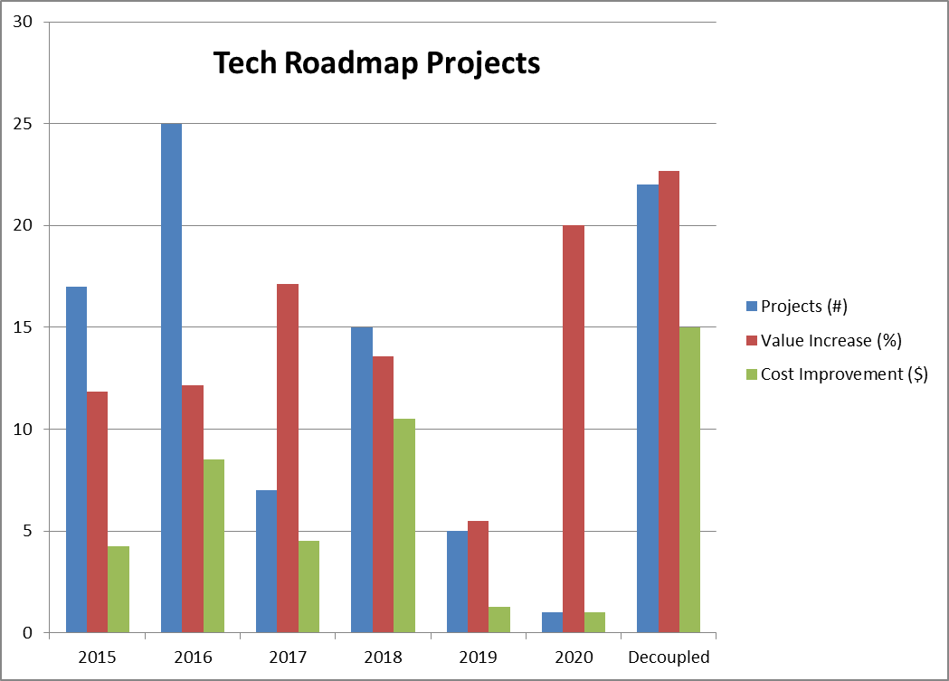
Programs by Year
GEOFF’S CHART

Slide 6
Torque Sensor

Slide 7
FE142: LOW COST SMALL DIAMETER TORQUE SENSOR
Description
  Develop torque sensor for EPS application
Motivation
  To reduce outer diameter of torque sensor
  To reduce cost of torque sensor
  To improve gain of the linear region of operation
  To improve rotational accuracy of the sensor

Slide 8
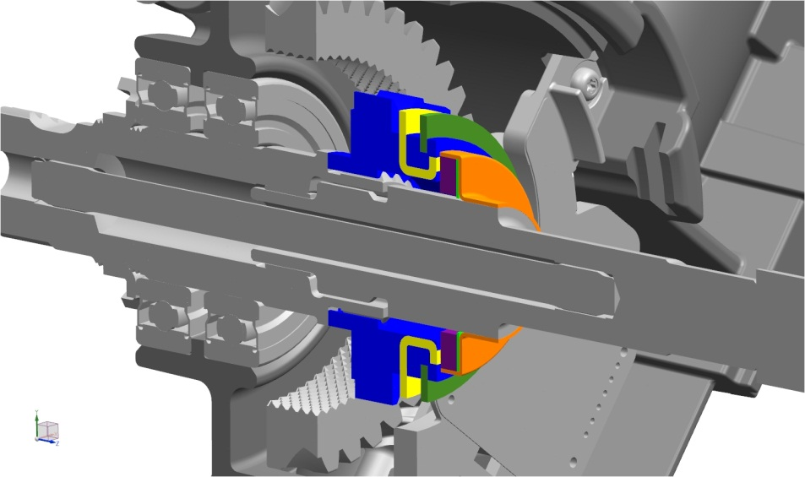
Plastic
Lower rotor
Disk 1
Upper rotor
Lower rotor disk 2

Slide 9
FE142: LOW COST SMALL DIAMETER TORQUE SENSOR
Upper rotor with axially magnetized magnets
Lower rotor placed axially on one side of the upper rotor
A. Lower rotor
or
B. Upper rotor

Slide 10
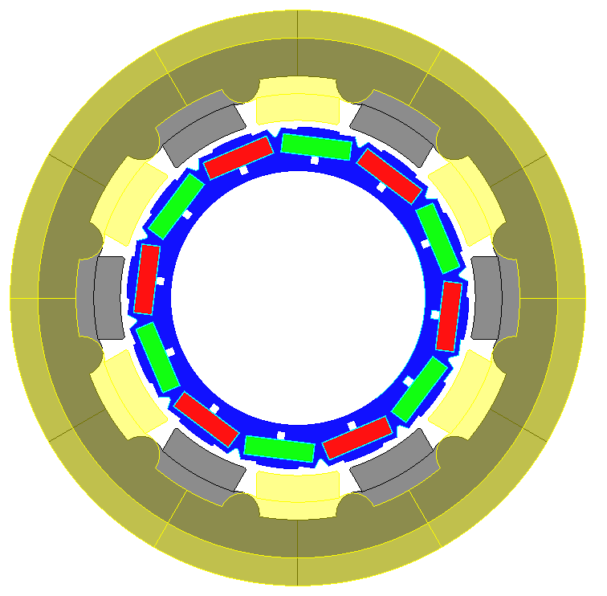
Current production IPM type torque sensor

Slide 11
FE142: LOW COST SMALL DIAMETER TORQUE SENSOR
Results
Gain and Linearity
Higher gain achieved
Good linearity

Slide 12
FE142: LOW COST SMALL DIAMETER TORQUE SENSOR
Results
Comparison with Prior Art Designs
Flux density [Gauss]
Ripple reduction
Parameter | Production design | Proposed design
Total magnet volume | 1305 mm³ | Reduction by at least 20% (for sintered magnet design)
Outermost diameter | 51.88 mm | Reduction by at least 4mm
Magnet volume reduction
Outer diameter reduction

Slide 13
FE142: LOW COST SMALL DIAMETER TORQUE SENSOR
A. Lower rotor – manufacturing challenges
Introduction of notches
Disk thickness =1.5mm
Disk thickness =0.65 mm for silicon steel

Slide 14
FE142: LOW COST SMALL DIAMETER TORQUE SENSOR
B. Upper rotor – manufacturing challenges
High residual flux density of magnet
Magnet expensive
Low residual flux density of magnet
Less expensive magnet
(Sintered magnet design)
(Ring magnet design)

Slide 15
FE142: LOW COST SMALL DIAMETER TORQUE SENSOR
Performance with modified geometry and property- Post Adjustment
Gain:
Sensor @ nominal position
Parameter | Initial Proposal-Ring Magnet | Proposed Design-Post Adjustments
Outermost diameter | 46.76 mm | 47.06 mm
Linear region gain | 27 Gauss/deg | 27.16 Gauss/deg
Max. peak-peak ripple | 2 Gauss | 2.5 Gauss
Comparison between initial and final proposed design
Parameter | Production design | Proposed design
Total magnet volume | 1305 mm³ | Injection molded magnet. Cheaper than sintered.
Outermost diameter | 51.88 mm | 47.06 mm
Linear region gain | 25.25 Gauss/deg | 27.16 Gauss/deg
Max. peak-peak ripple | 6.74 Gauss | 2.5 Gauss
Comparison between production and final proposed design

Slide 16
Closed Loop Steering Control
(MRA Pursuit)

Slide 17
EPS Performance and Robustness Evolution
Algorithm enhancements to address special vehicle conditions (oversteer, understeer, low-mu, etc)
EPS
Optimized
robustness & feel
Closed Loop
EPS
Steering Feel Robustness
Algorithm enhancements to address variations (friction, wear, temp, etc)
Technology change to address variations (friction, wear, temp, etc)
Open Loop
EPS
Early EPS
Development focused on steering feel performance to meet/exceed hydraulic steering
Steering Feel Performance

Slide 18
EPS Open-Loop Control vs. Closed-Loop Control
Criteria | Open-Loop Control | Closed-Loop Control
Performance Robustness Robustness to variations in manufacturing, friction, wear, usage, ... | Dedicated algorithms required to manage performance variation (Friction Learn/Comp Temperature Comp, SRS Comp, Active Pull Comp) | Compensates for variations by design to give consistent performance
Road Feel / Vehicle Condition Perception of mu-change, uneven surfaces, bank angle, over steer, under steer, … | Natural balance of forces reflect road surface and vehicle condition | Requires special detection and control action to reflect changes in the road surface and vehicle condition
Disturbance Rejection Capability for rejecting disturbances from road, motor, vehicle, etc. | Requires specific algorithms and tuning | Closed-loop control inherently rejects disturbances, depending on disturbance frequency and servo bandwidth
Tuning Interface Relationship between tuning parameters and steering feel | Friction & Damping: compensate effects to get desired friction & damping feel Assist: Indirect relationship to driver torque. Effort: open-loop estimation of driver torque | Friction & Damping: directly calibrate desired steering feel performance Effort: direct relationship to driver torque
Tuning Process Coupling among the tuning parameters, tuning difficulty and time | Desired feel is achievable but requires a structured tuning process and iterations (processes are well developed) | High level functions such as effort, return, and damping have less coupling
Tuning Portability Ease of porting tuning across platforms | Limited portability, but mature industry experience | Tuning calibrations potentially portable, but depends on vehicle response Some calibrations require vehicle test data

Slide 19
EPS Closed-Loop Control Technology – Status and Timeline
Future
Present
2012
Winter test
Closed loop control strategy finalization
Prepare for commercial offering
Safety concept
Advanced feature development
Operating space transition
Continuous improvement
Controller and gear build
Bench test
Vehicle integration
Internal vehicle build
Demonstrated performance to GM
Control design
Numerical simulation
Control strategy selection
AUTOSAR Autocoding
Prototype software build
Concept generation
Literature survey
Market analysis

Slide 20
Closed-Loop Control System Architecture
Friction
Inertia
Road Wheel Imbalance
Vehicle Lead/Pull
Target Generator
Desired
HwTrq
Tracking
Control
Motor
Control
Steering System
Vehicle
+
Compensation
Effort
Damping
Hysteresis
Return
Steering State
Rack Force
Vehicle State
Surface
Bandwidth
Stability
Sensors/
Observers

Slide 21
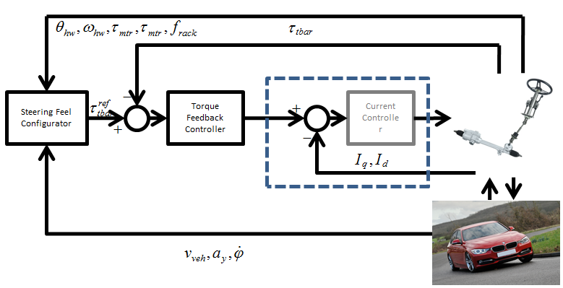
Closed Loop Steering Control

Slide 22
MRA Function Implementation Status

Slide 23
MRA Closed Loop Sub-functions

Slide 24
High Ratio CEPS

Slide 25
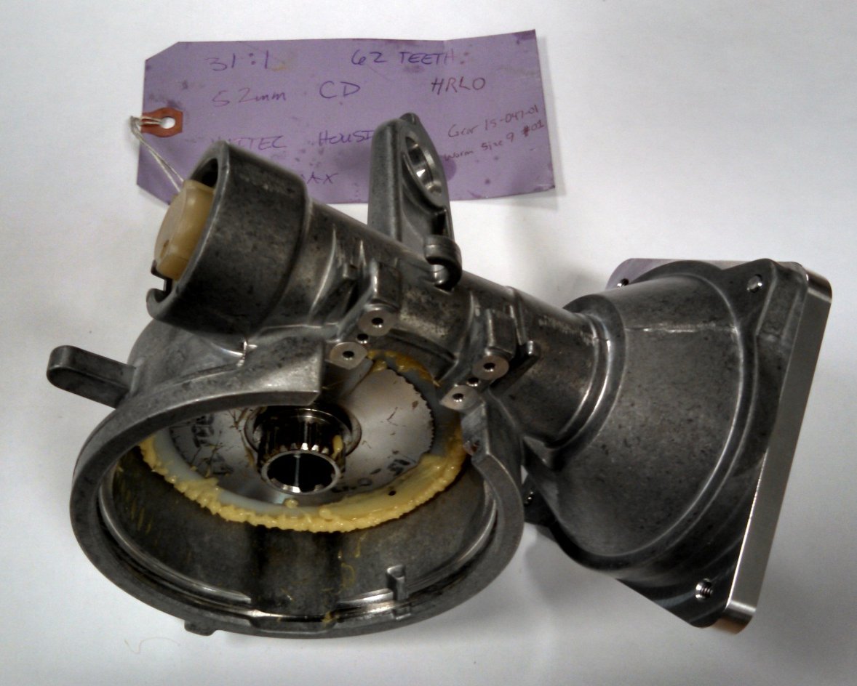
Higher Ratio (31:1) A/M

Slide 26
Status
31:1 First build complete
  CMM data good after 2 iterations of gear cutting for over-ball adjustments
  Assembly run in at 60 Nm
  Backdrive friction set to ~1.2 N-m average
    Once per rev similar to Haitec production (see following slides)
  Contact pattern looks good visually – measurement data pending (see following slides)
  Marginal Efficiency average measured ~87.5% (see following slides)
  First running noise test set for Monday 02MR15 28:1 and 30:1 first cut gears are being inspected on CMM
  Adjustments may be required
31:1 First build complete
  CMM data good after 2 iterations of gear cutting for over-ball adjustments
  Assembly run in at 60 Nm
  Backdrive friction set to ~1.2 N-m average
    Once per rev similar to Haitec production (see following slides)
  Contact pattern looks good visually – measurement data pending (see following slides)
  Marginal Efficiency average measured ~87.5% (see following slides)
  First running noise test set for Monday 2Mr15
28:1 and 30:1 first cut gears are being inspected on CMM
  Adjustments may be required

Slide 27
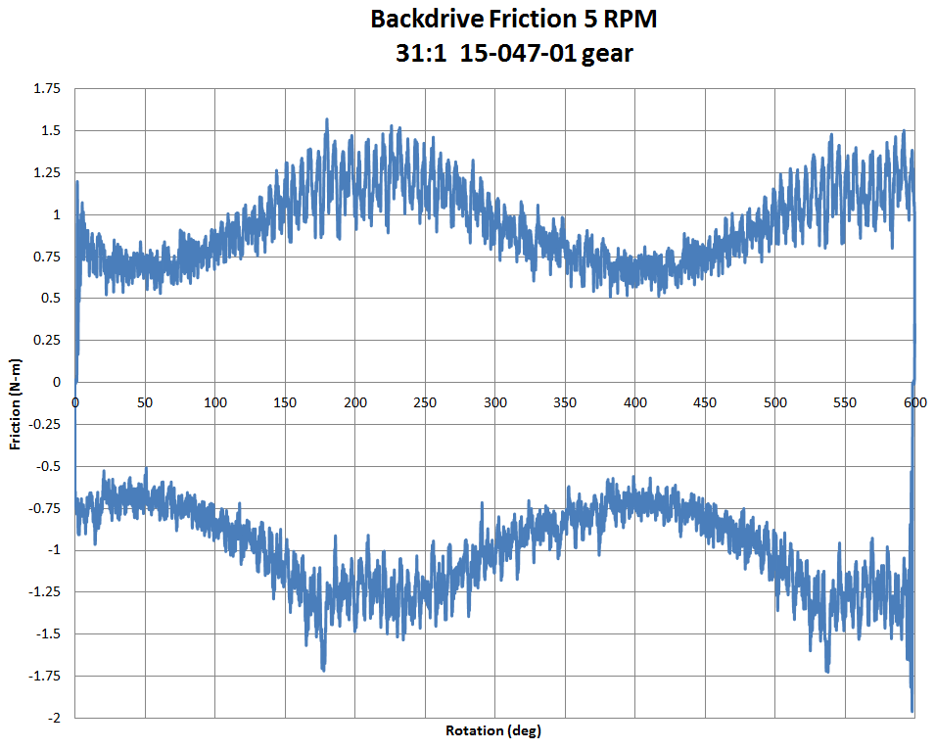
31:1 Backdrive Friction Data

Slide 28
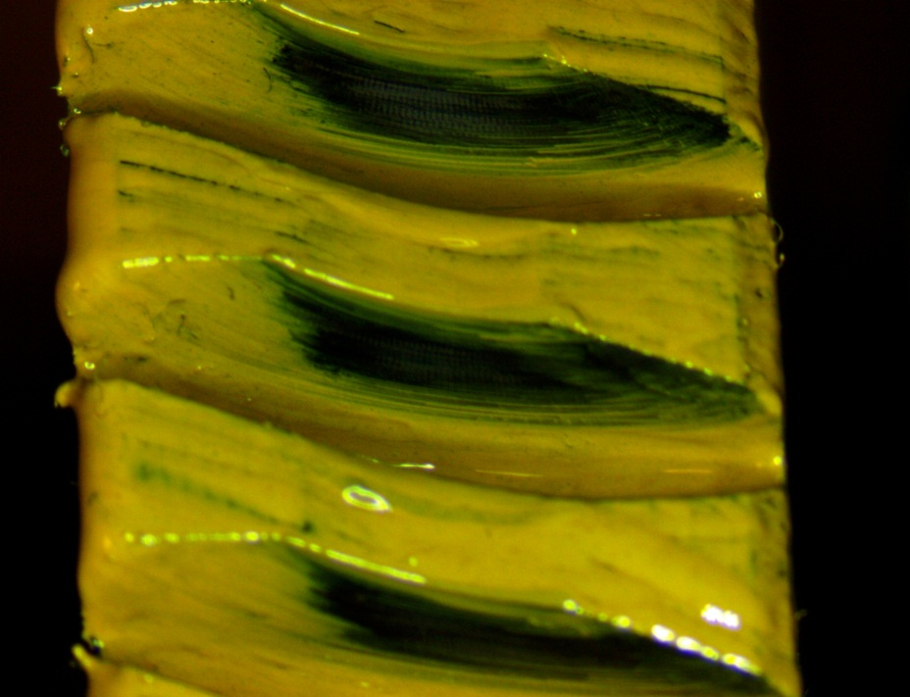
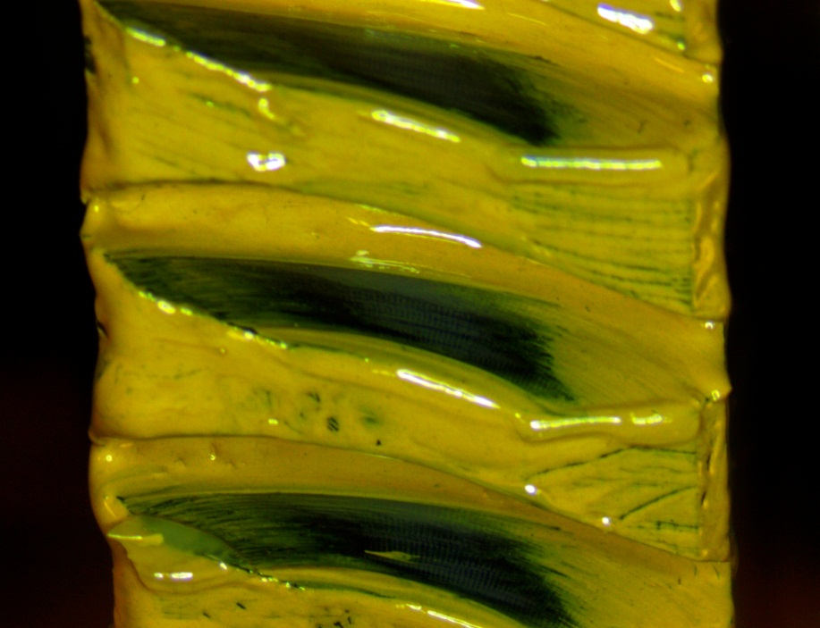
31:1 Contact Pattern Pictures

Slide 29
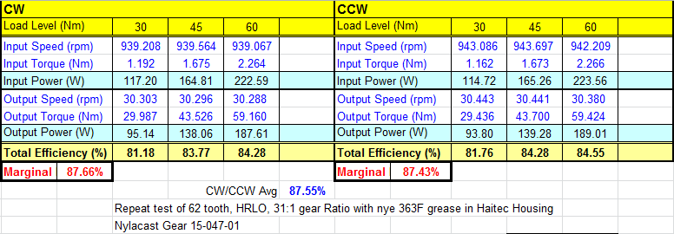
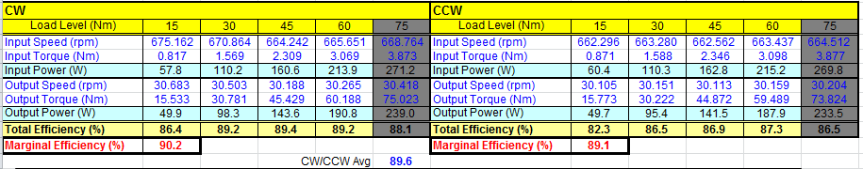
31:1 Efficiency Data
New 31:1
REF Production Gamma 22:1

Slide 30
Motor Optimization

Slide 31
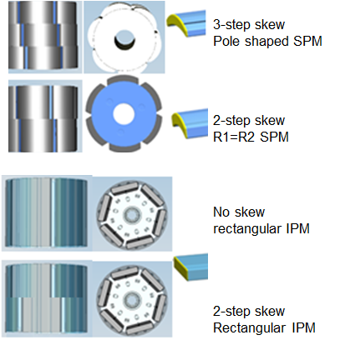
PP-124: Cost Optimized Motor Design (IPM/skew/pole shape/WIH)
Description
  Develop Cost Optimized Motor
Motivation (10)
  Reduce Material cost in Motor
Deliverables
  Determine if Larger OD Rotor is a Cost Advantage
  Determine if Higher Grade Magnets vs cost is a feasible option
  Determine which stator / winding design is optimal for cost
  Determine if shape of magnet has cost impact
Timing
  Fiasa & PSA BMPV (2016 - SOP)
Team Members/Customers
  Rakib Islam
  Bryan Williams
  Ken Webber
  Steve Collier-Hallman
  John Redwine

Slide 32
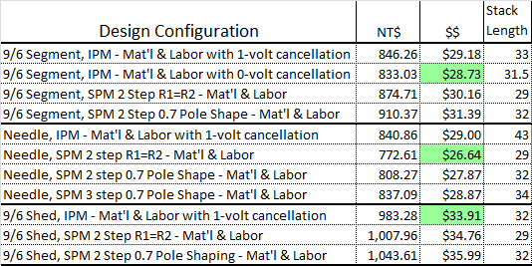
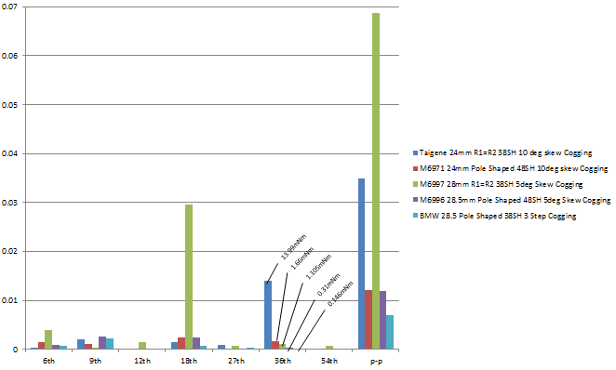
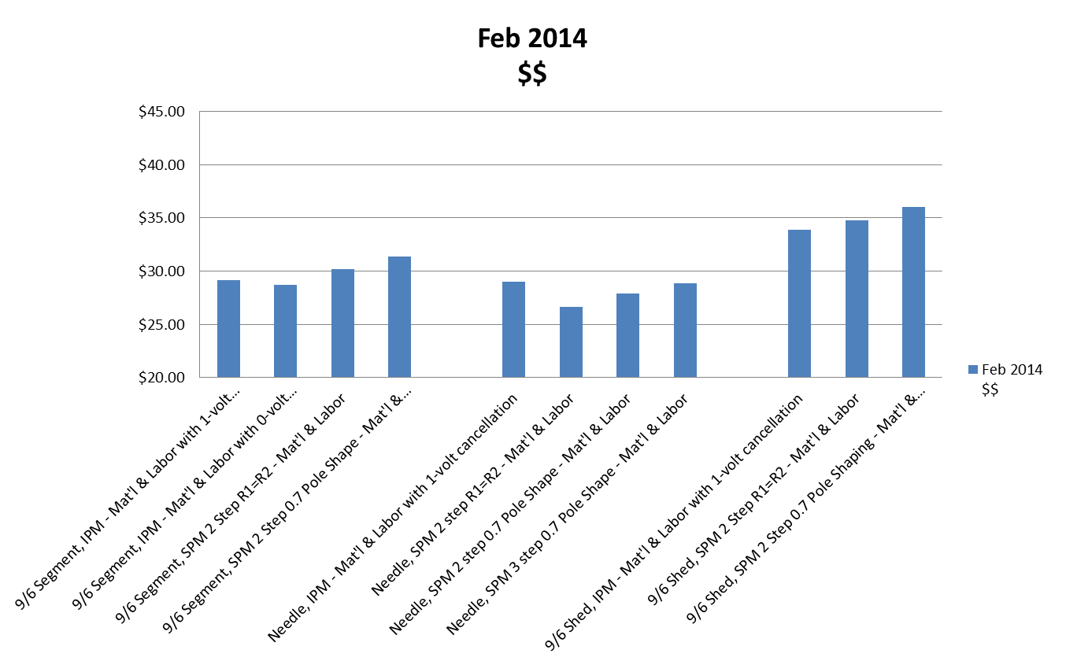
Cost Motor Model and
Cogging Cancellation
Cogging Torque
Note: Needle, SPM 2 Step R1=R2 Assumes 0.25 Volt Cancellation

Slide 33
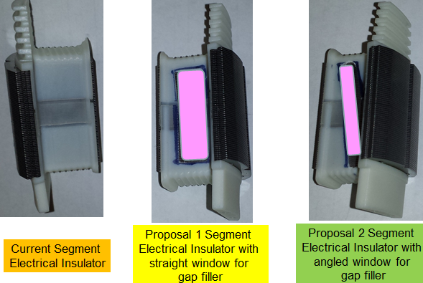
PP-126: Heat Management for Motor
Description
  Reduce Motor generated heat from Segment/Needle Stator designs
Motivation (9)
  Segment and Needle Wind Motors with plastic Insulators generate more heat than Shed Wound motors
Deliverables
  Determine if gap filler can be added prior to winding to get direct heat transfer to stator
  Determine if thermally conductive coatings (Bergquist epoxy coat) on stator instead of plastic insulator reduces motor thermals.
  Determine which stator / winding design is optimal for thermals
Timing
  Fiasa & PSA BMPV (SOP - 2016)
Team Members/Customers
  Rakib Islam
  Bryan Williams
  Ken Webber
  Joanne Tersigni
  Julie Kleinau

